Slide 1


Credit Card Management
By:
Deepak Ganesan
Prachi Diwakar
Rajesh Ravindrareddy
Rushikesh Bhattad

Slide 2

SCOPE
To build up business standards.
To monitor customer’s transaction on daily, weekly and monthly basis.
To categorize customers on transactional basis.
To personalize offering based on customer’s analysis and strategizing development of marketing campaigns to directly address customer behavior.

Slide 3

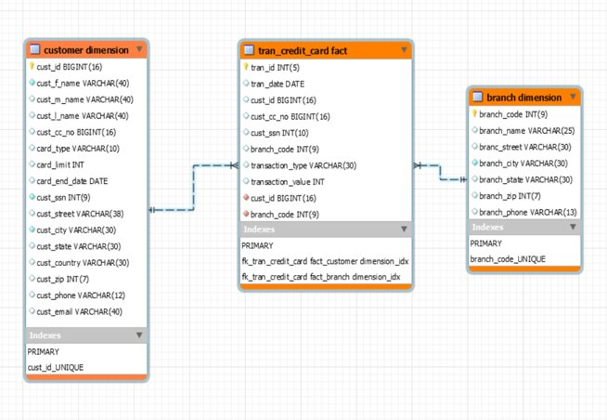
Data Warehouse Schema

Slide 4



HDFS
HIVE
SPARK
Technology Used

Slide 5
HDFS (Hadoop Distributed File System)
Distributed storage
Batch processing
Horizontal Scalability
HIVE
Takes very less time to write Hive query in comparison to MapReduce code
Keeps queries running fast
Simple to learn and use
Supports Partitioning and Bucketing
We can use complex data types in Hive
Advantages

Slide 6
SPARK
Advantages
Best processing unit in hadoop and non hadoop environment
In-memory data processing engine
Executes batch processing jobs faster than MapReduce
Supports parallel processing
Ability to handle both batch and streaming data
Can work on Stand alone or with YARN,MESOS

Slide 7
Work Flow
Raw Data
Loading Data into HDFS
Importing the source data into hive using spark
Validate the data
YES
Create desired tables in hive
NO
Check the data and validate again
Process the data using Spark

Slide 8

Outputs:

Slide 9
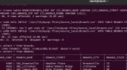
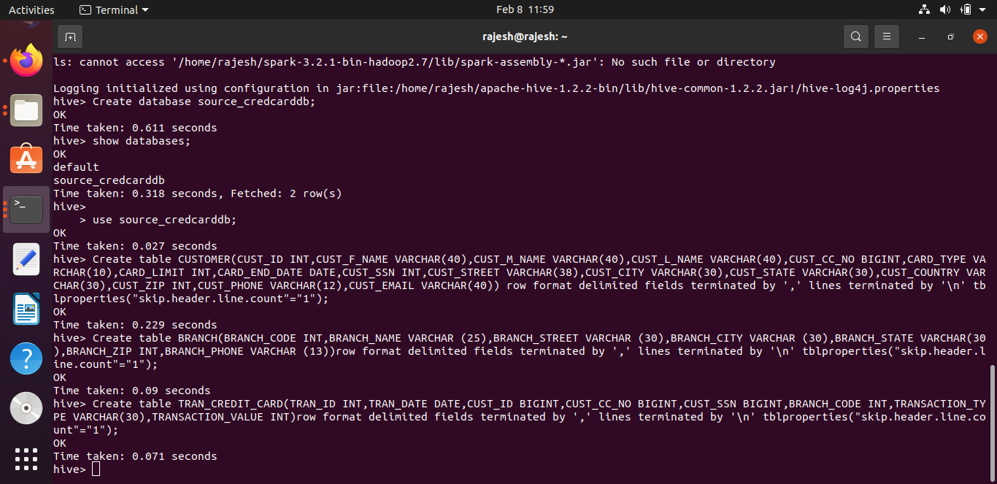
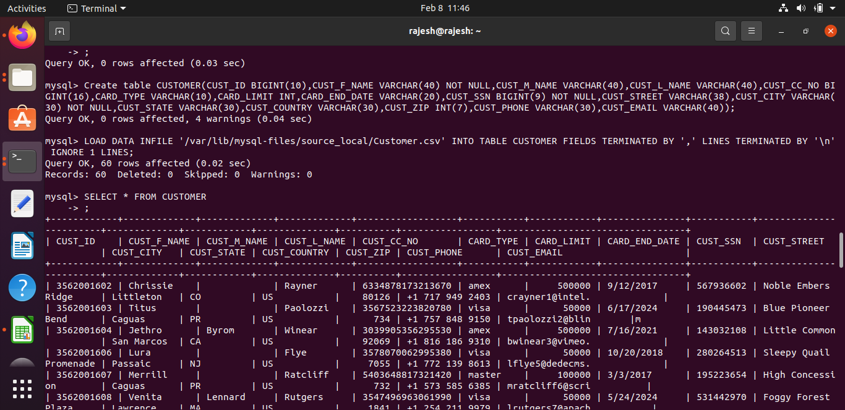

Slide 10
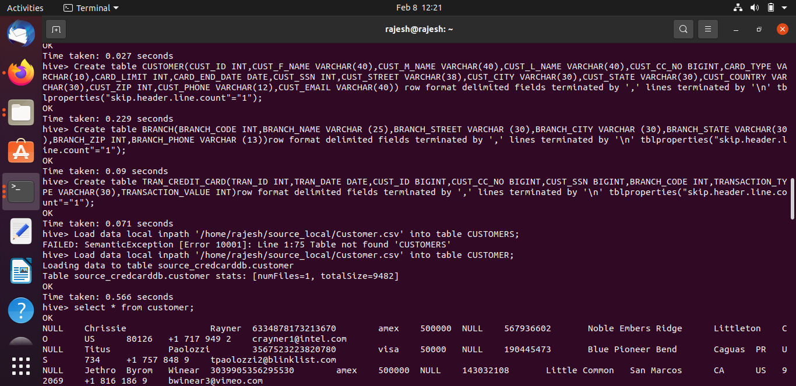
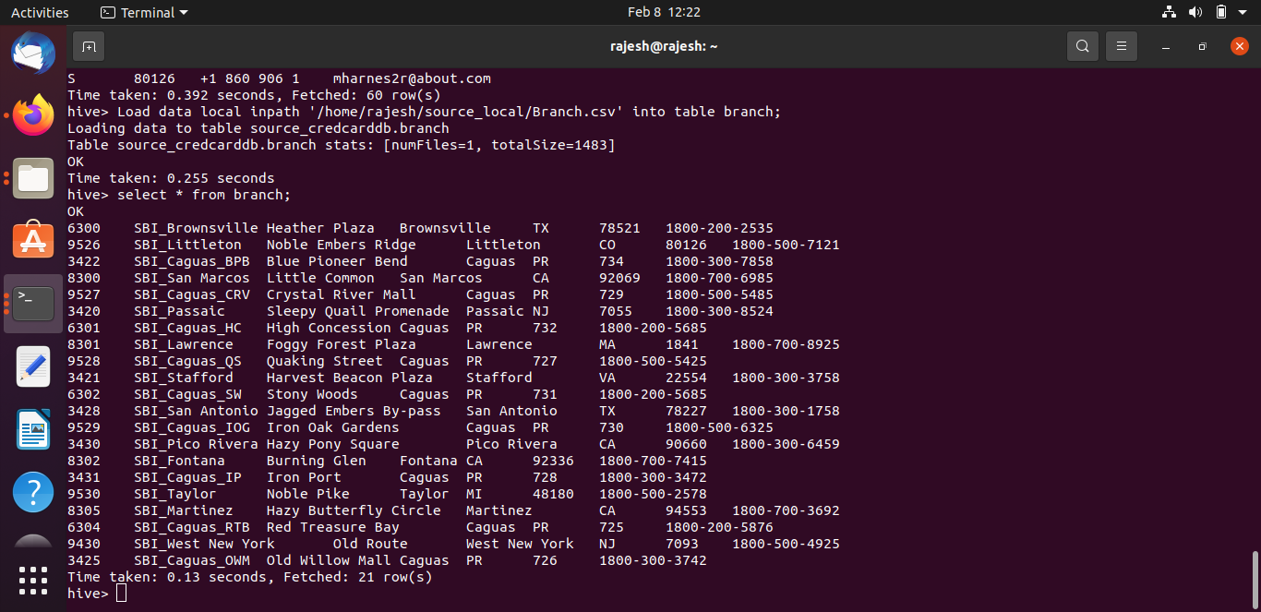

Slide 11
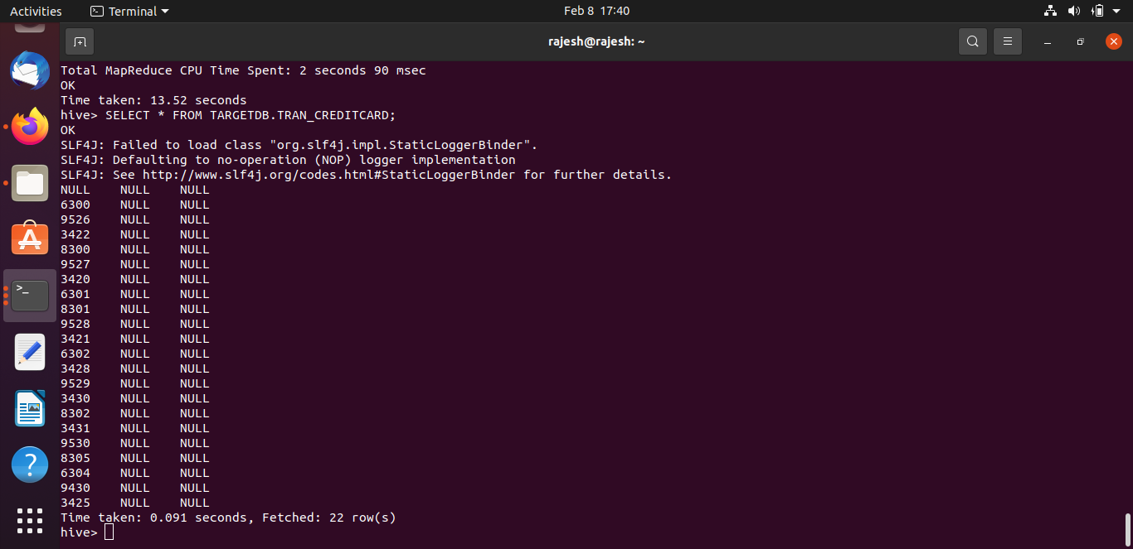
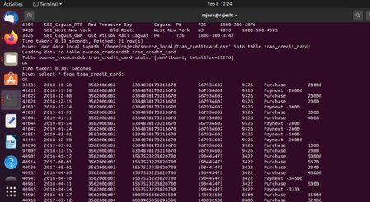
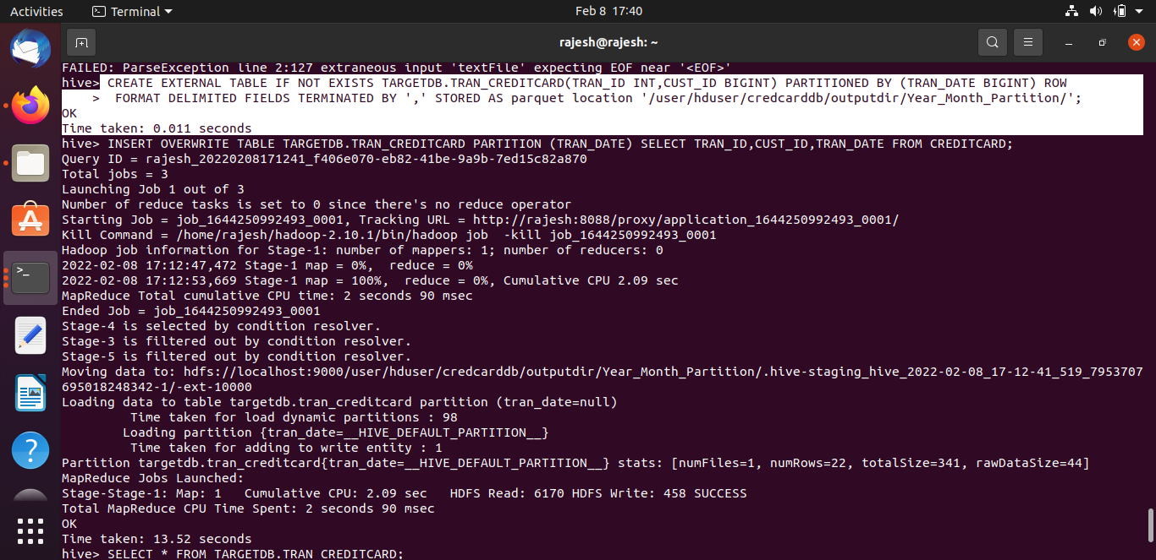

Slide 12
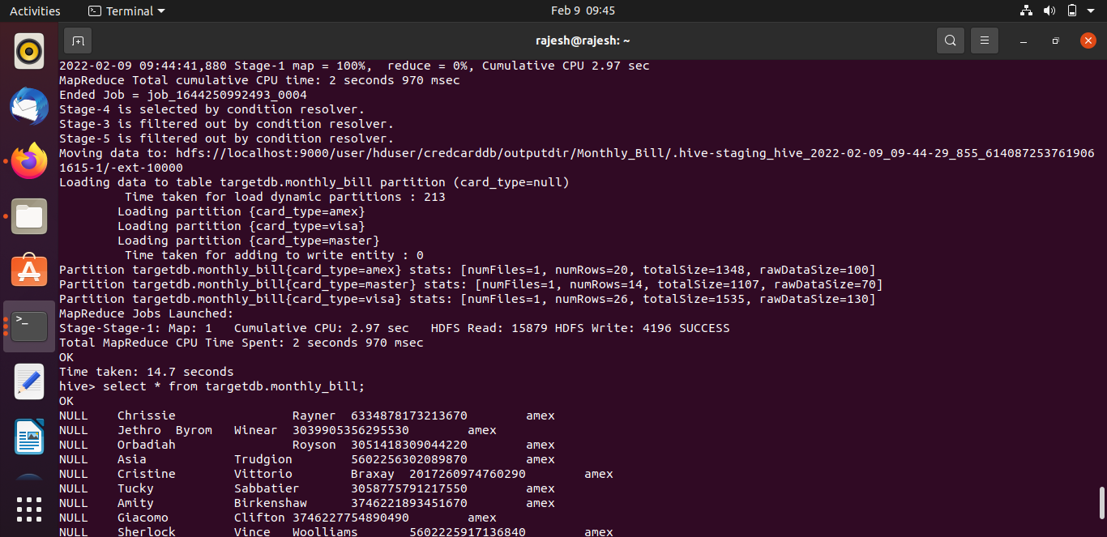
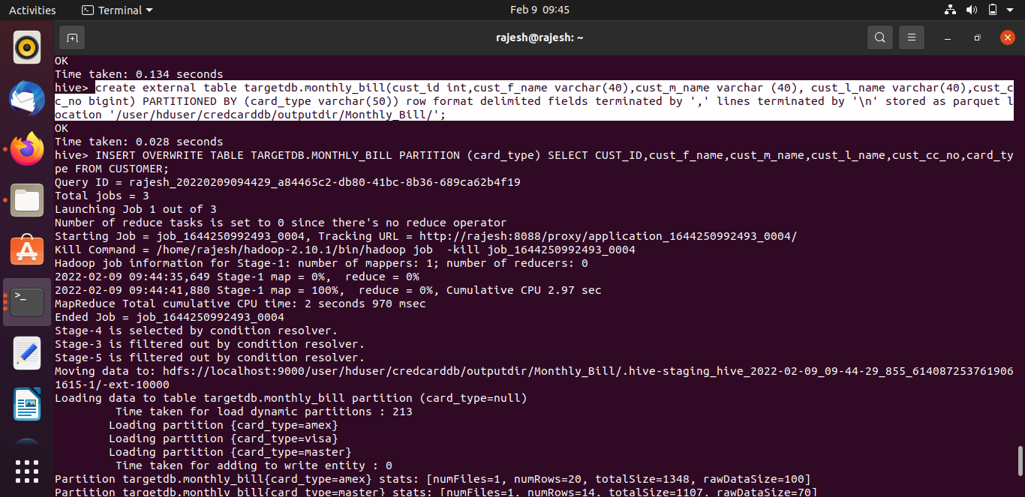
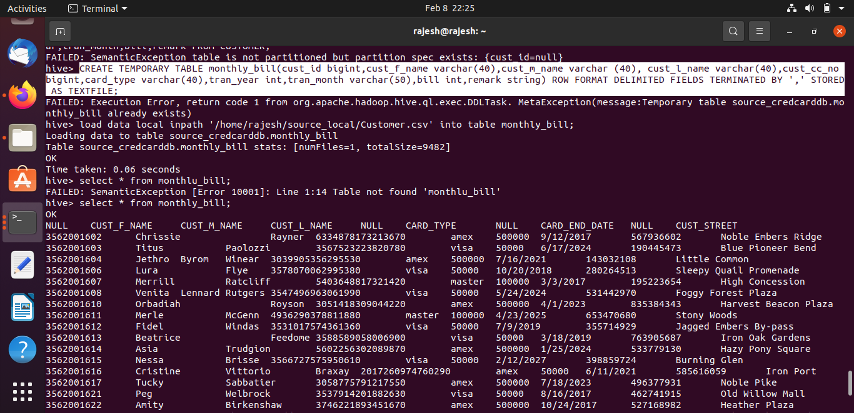

Slide 13
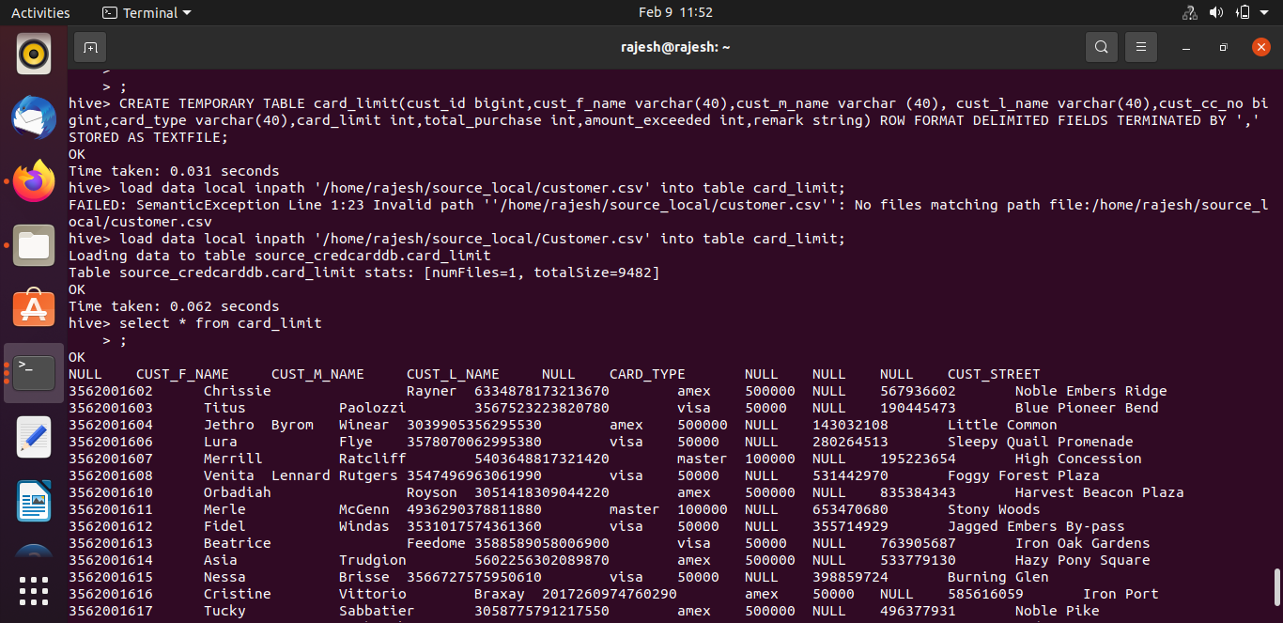
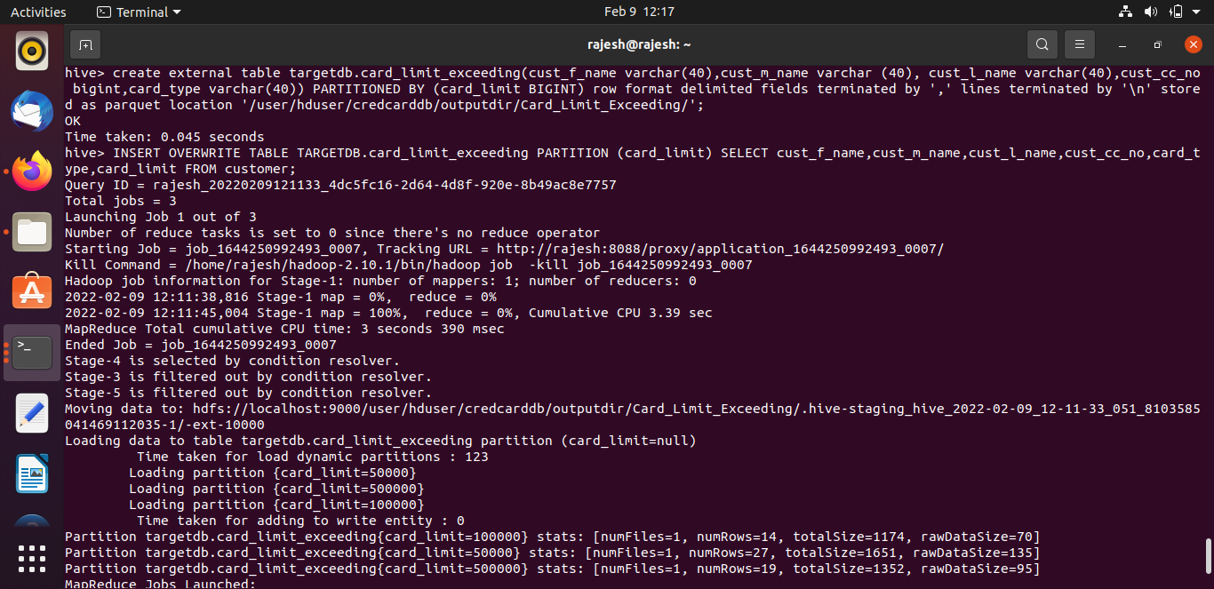

Slide 14
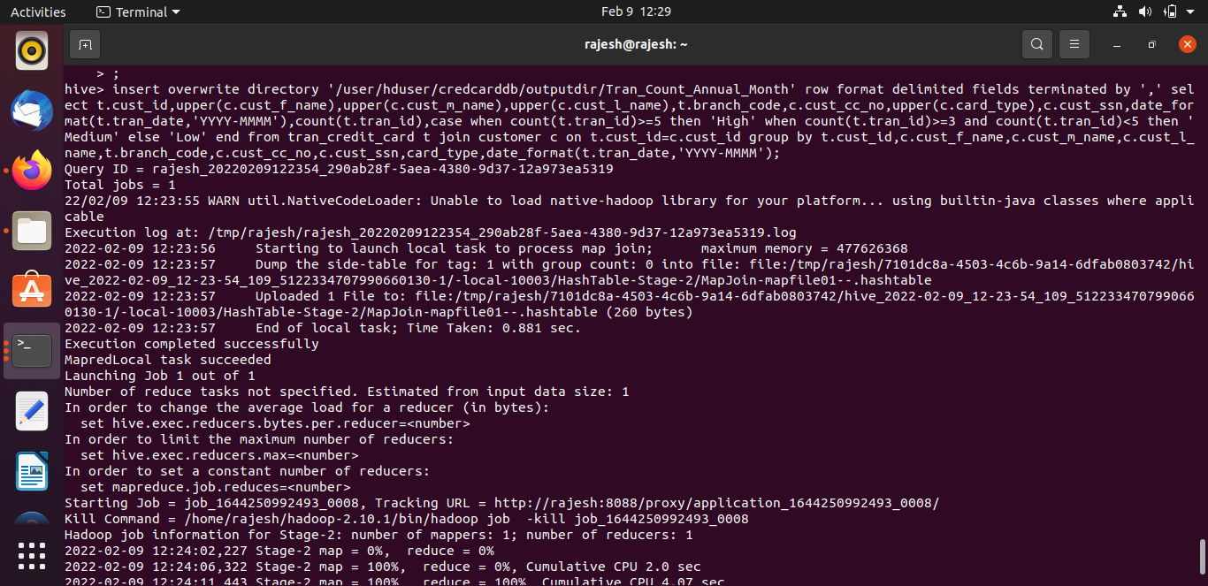
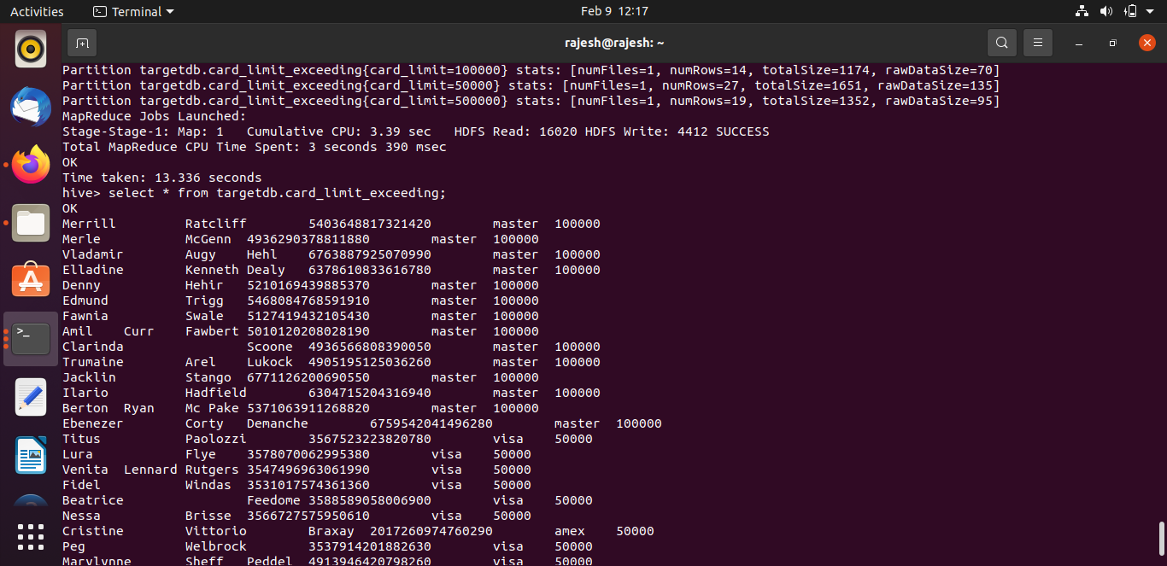
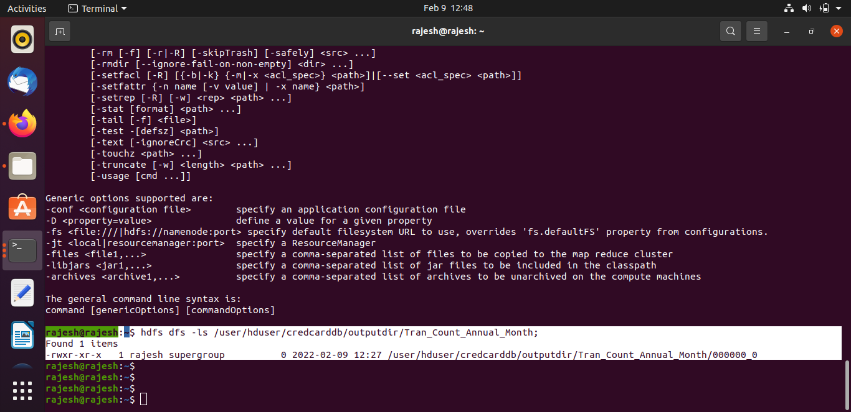

Slide 15
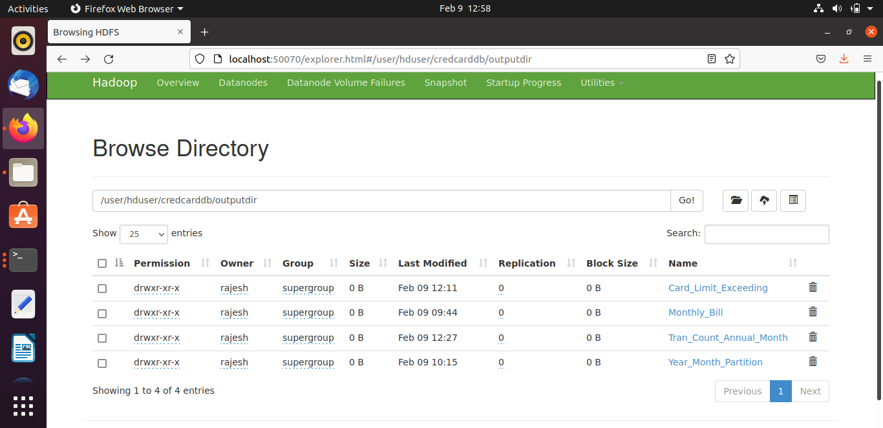
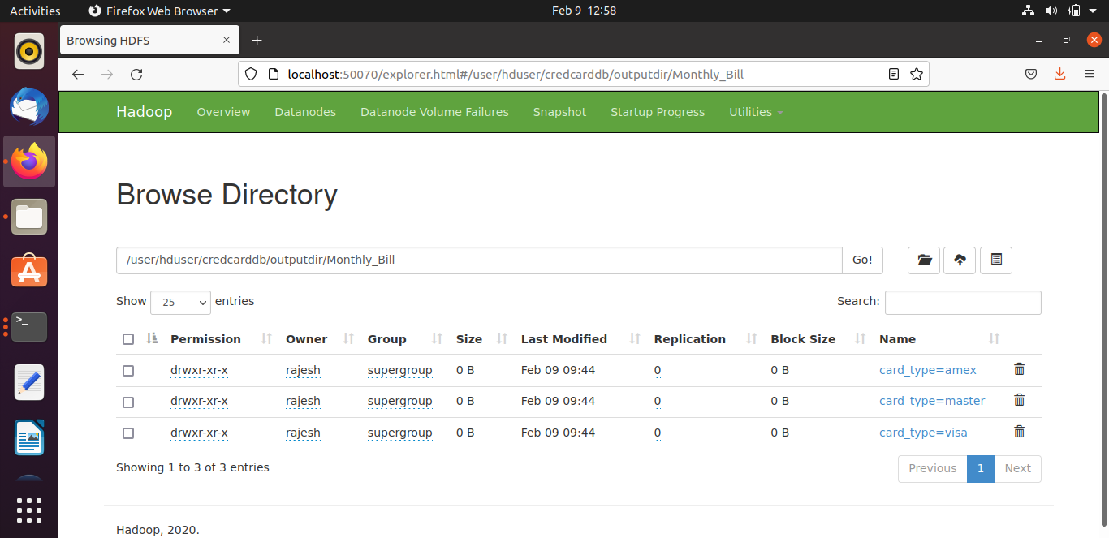
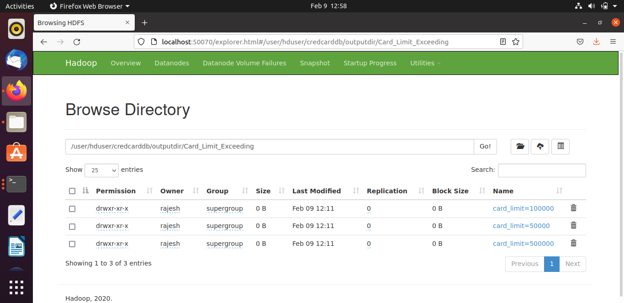

Slide 16
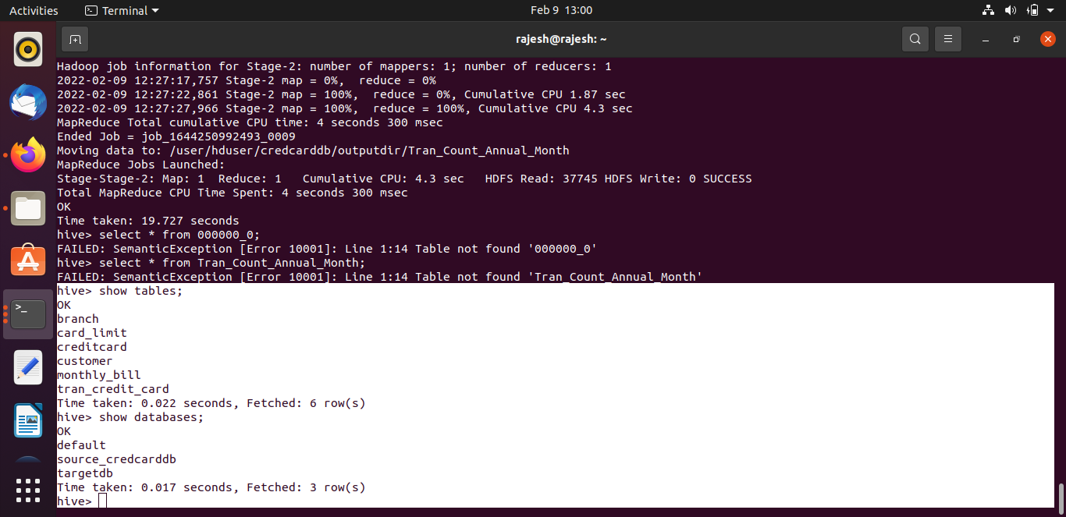
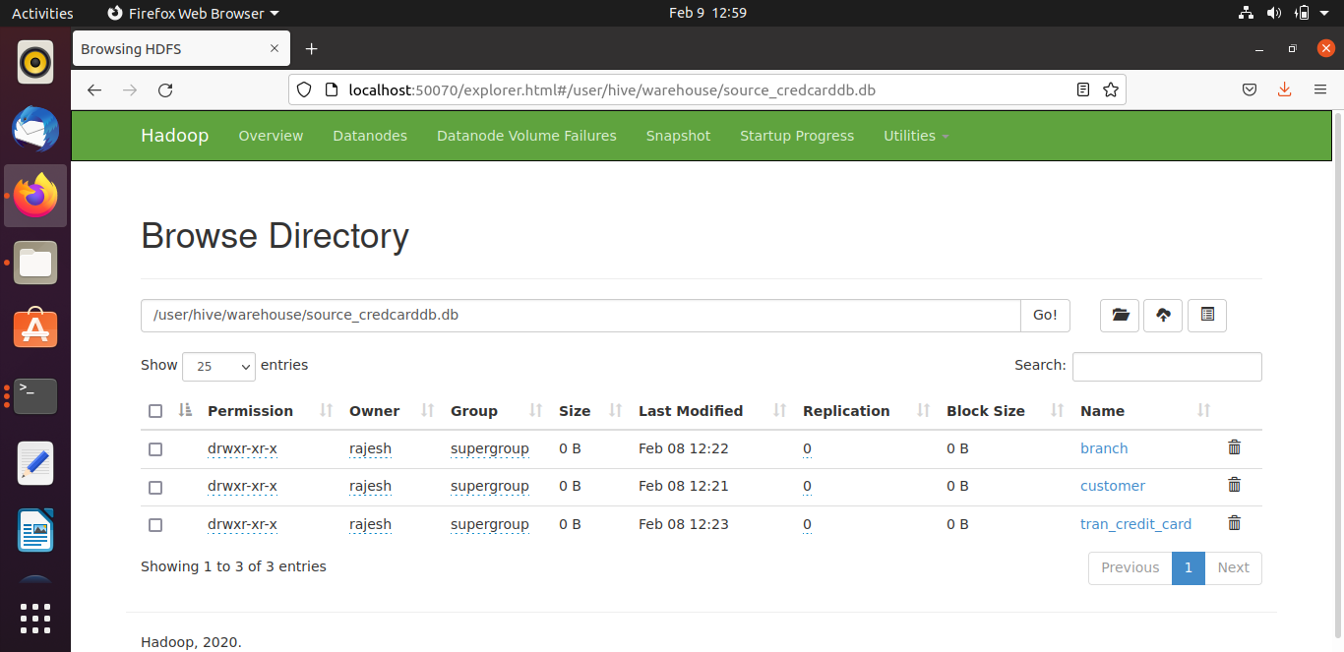

Slide 17
Conclusion
Observing and analyzing the trends and pattern in the customer’s transactional behavior.
We can customize offers to ensure customer satisfaction and maximize returns.
Data processing in Spark is much faster than Hive.
Hive supports partitioning to improve the performance but partitioning is suitable for only small datasets.

Slide 18

THANK YOU

